Slide 1
Pixhawk and other electronics
A primer
Phil Baldwin
11/8/19

Slide 2
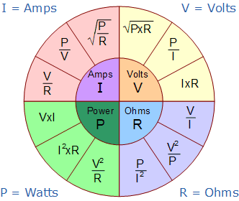
Electrical Units
Voltage
Volts (V)
“Flow” potential
The only supplied value by a battery
Resistance
Ohms (Ω)
Characteristic of a circuit
Current
Amps (A)
Resultant of potential and resistance
Power
Watts (W)
1 J/s

Slide 3

Series and Parallel
Ex: AA batteries, nominal 1.5 V, 2000 mAh capacity per cell
(Just a regular alkaline battery, NOT LiPo)
Series connections increase voltage
If we put 4 AAs in Series, what is the resulting voltage of the pack? The capacity?
Voltage: 6V Capacity: 2000 mAh Total Energy: 12 Wh
Parallel connections increase capacity
If we put 4 AAs in Parallel, what is the resulting voltage of the pack? The capacity?
Voltage: 1.5V Capacity: 8000 mAh Total Energy: 12 Wh
- 1.5v +
- +
+
-

Slide 4
LiPo Batteries
Provides an electrical potential → Voltage
Is constructed of cells of a given capacity (mAh)
Capacity is current * time, hence Amps (or milliamps), over an hour
Describing a battery by saying “it has 7000 milliamps” is nonsensical, though we can probably guess what you mean
Does not “provide” a set amperage
Ex: a 20C 4000 mAh LiPo can pump out 80A without damaging the battery, but it will NOT pump out 80A all the time
Most LiPos are sold as a nS1P arrangement, where n is the number of cells in series, and there is just that one set of serial cells (i.e. no parallel arrangement)

Slide 5
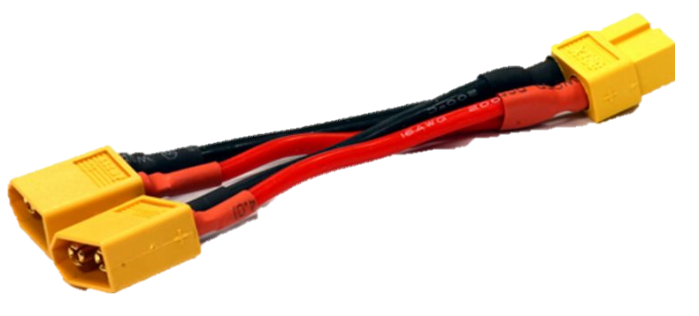
LiPos – Parallel and Series
Generally buy a battery with the series arrangement already done
Example: You design your propulsion system to use a 4S battery. It is much easier (and probably cheaper) to buy a 4S battery than two 2S batteries and put them in series
Not unheard of to buy two identical batteries and put them in parallel to double the capacity.
Example: You are planning an extremely long mission which will require approximately 16,000 mAh on a 4S battery. You may not be able to find a single 16,000 mAh 4S battery, but you can source two identical 8,000 mAh 4S batteries.
Put them in parallel configuration using additional wiring, such as this.
Be sure to match connector styles, or plan to convert.

Slide 6
Batteries – Common issues/FAQs
Voltages for LiPos are given as a nominal voltage, 3.7V, which is the voltage at approximately 50% charge
Never discharge a LiPo below 3V/cell
Example: Absolute minimum on a 4S would be 12.0V
“We just want to fly another minute” is a bad excuse
“The wires for this battery are huge, but I want to solder on an XT60.”
You probably purchased a high-discharge rated battery than can handle 120+ amps…there is a good reason the wires are large. Solder on an XT90 and then make or buy a XT90 to XT60 adapter.
“How do we know how much battery we used?”
Most chargers will read out the mAh charged back into the battery
Log the mAh consumed within your Pixhawk, the save out the log file

Slide 7
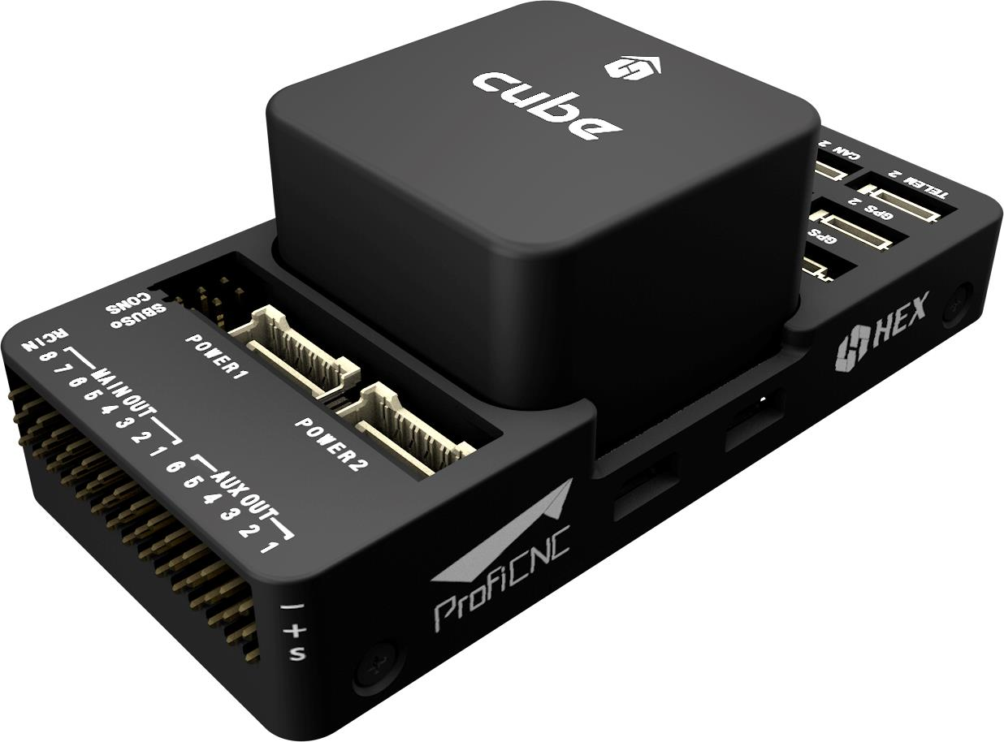
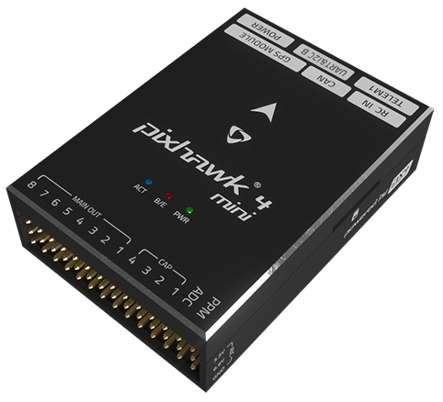
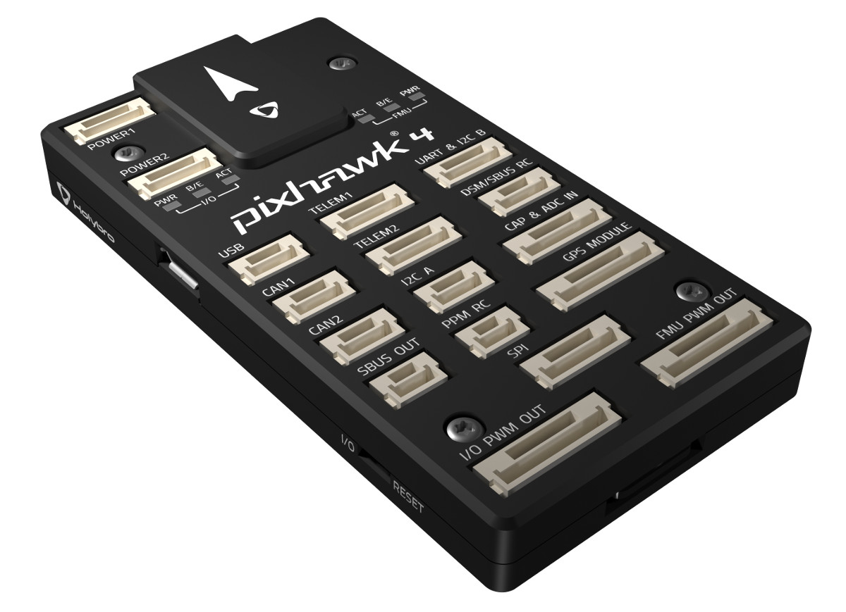
Pixhawk/PX4/Ardupilot
“Pixhawk” refers to the physical hardware
Current models
Pixhawk 2.1 (The Cube)
Pixhawk 4
Pixhawk 4 mini
“PX4” and “Ardupilot” refers to the software (firmware) running onboard
QGroundControl software can install PX4 or Ardupilot
Mission Planner software can only install Ardupilot
PX4 ≠ Pixhawk 4

Slide 8
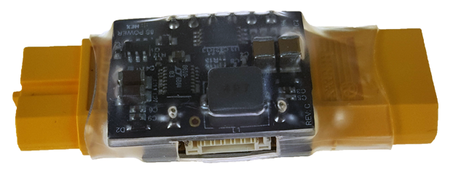
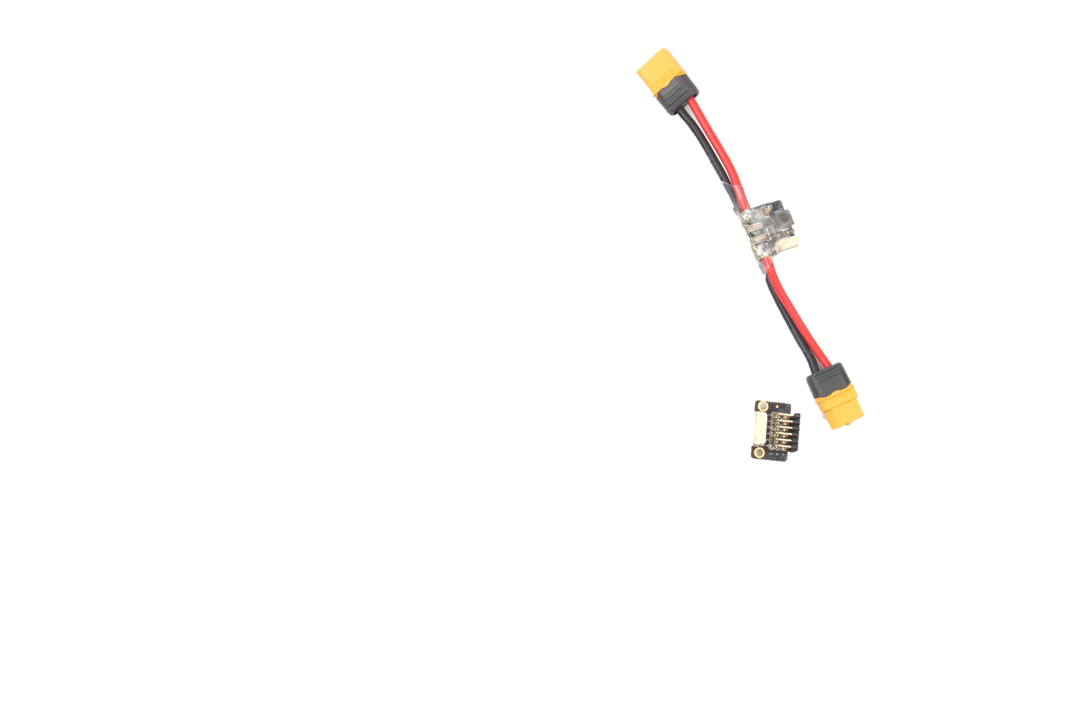
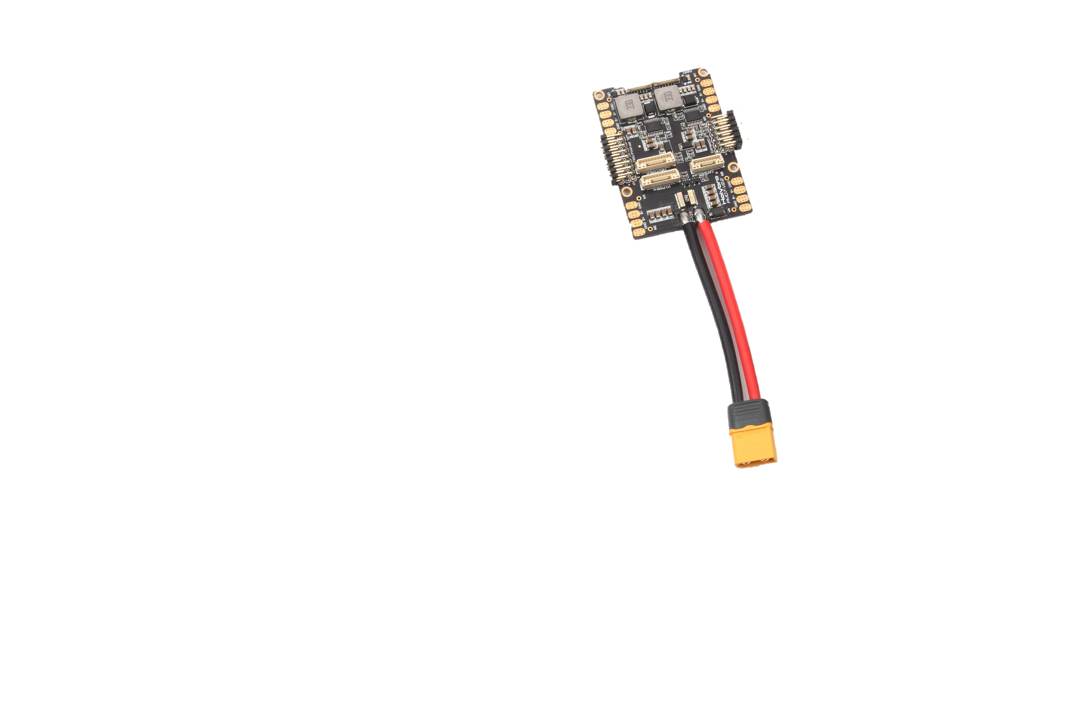
Powering your Pixhawk
Different models have slightly different power connectors, but should come with the correct items to connect to a LiPo battery
Pixhawk 2 has a “power module” that sits between your LiPo and your ESC
Comes pre-installed with XT60s
Also measures battery voltage and current draw
Nice to monitor for mission duration and battery health
Pixhawk 4 has options
A huge, annoying power distribution/IO board that is great for quad- and octo-copters
In-line power module and compact IO breakout (please buy this)

Slide 9
Pixhawk – Common issues/FAQs
The connectors are delicate – be nice
Be mindful of board orientation and mounting
Remember that wires take up space
And have non-zero weight
Purchase 915 MHz radios, not 433 MHz
“The GCS says the battery is too low.”
Make sure the power module is properly set up in your GCS
“There is no signal to the servos.”
Make sure the safety switch has been pressed (aka vehicle is “unsafe”)
Make sure the servos are plugged in to the right location
Make sure the flight mode is set to your desired mode

Slide 10
Servos
Defining specification is torque
Determining your torque requirement is not straightforward
Depends on aerodynamic loads, hinge axis alignment, manufacturing errors, etc.
LOTS of manufacturers to choose from
Lots of shapes and sizes
Thin servos might be nice for wings, but probably costs more than a similarly-torque-spec’d “standard” looking model
Make sure their required voltage is being met
More and more “HV” or High Voltage servos on the market that require more than 6 volts, which is the highest that many ESC-borne BECs will do
Too low of a voltage can lead to an odd twitch

Slide 11
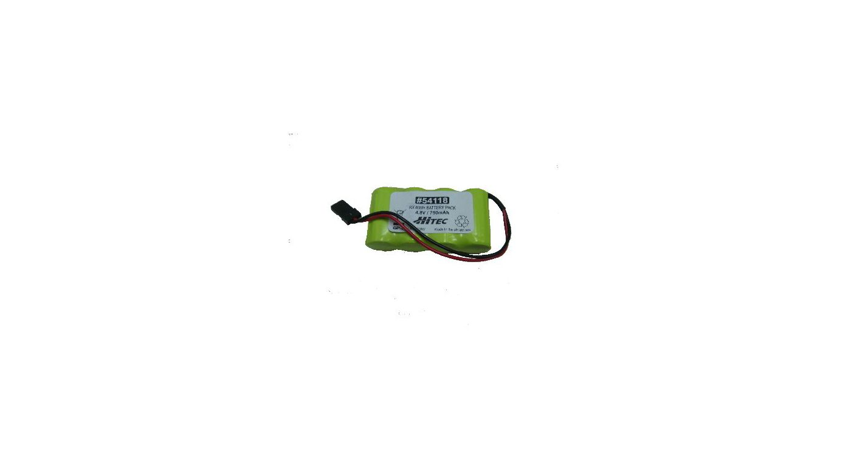
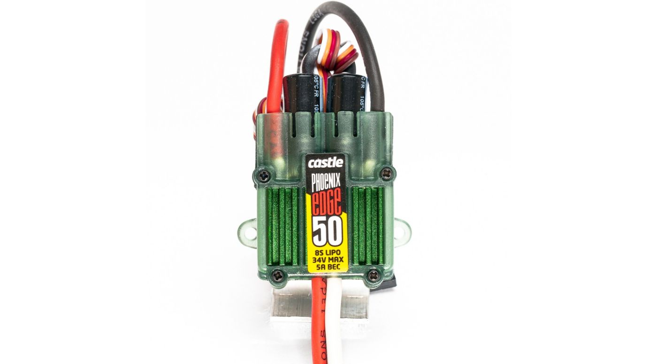
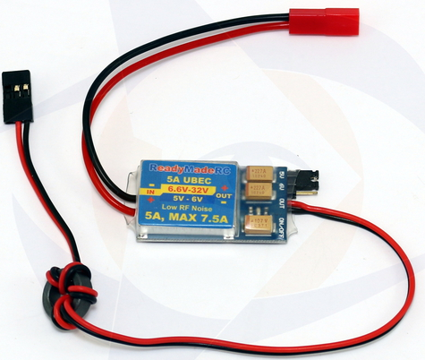
Powering your servos
Servos do not get powered by the Pixhawk directly
Voltage must be provided by one of three ways
Standalone battery pack (4.8V NiMH packs, aka receiver packs can be used)
BEC that is built-in to your ESC (Most common for this project)
Note that if your ESC says “opto” or “opto-isolated”, then there is no BEC
Standalone BEC
Could be on a separate LiPo as a safety mechanism for running your propulsion battery figuratively into the ground, or be similar to the Pixhawk Power Module (a passthrough)

Slide 12
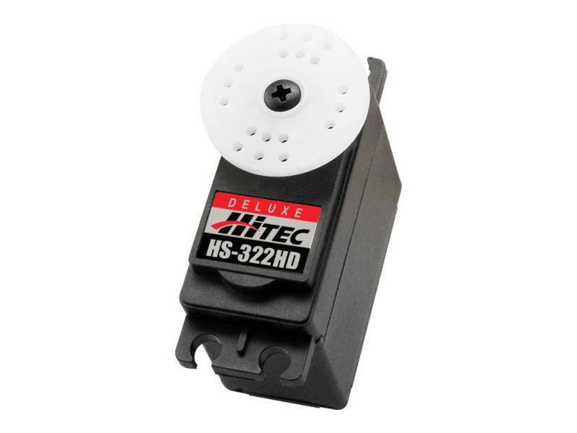
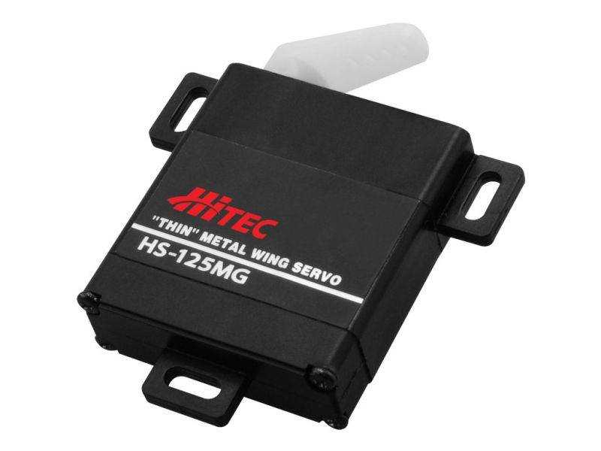
Powering your servos, example
Must make sure that current rating of BEC (or battery) is greater than all your servos’ max current draw (with some margin, maybe 25%)
 | Aileron, Elevator Servos | Rudder Servo | Total
Make/Model | Hitec HS-322HD | Hitec HS-125MG
Quantity | 3 | 1
Max current (each) | 800 mA | 1200 mA
Voltage required | 4.8 – 6.0 | 4.8 – 6.0
Simultaneous max current | 2.4 A | 1.2 A | 3.6 A

Slide 13
Positive, Negative, and Signal
White/Yellow/Orange: PWM Signal Red: +VDC Black/Brown: -VDC
Servo signal: Pulse Width Modulation
0% deflection: 1100 μs (Note, this can sometimes be reduced to 1000 μs)
50% deflection (“centered”): 1500 μs
100% deflection: 1900 μs (Note, this can sometimes be increased to 2000 μs)
RIGHT |  |  |  | WRONG

Slide 14
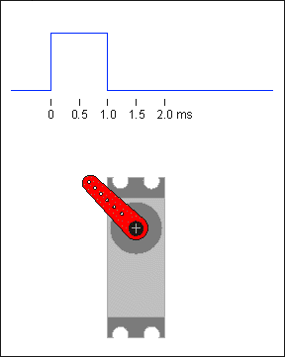
PWM Signals
Servo signal: Pulse Width Modulation
0% deflection: 1100 μs (Note, this can sometimes be reduced to 1000 μs)
50% deflection (“centered”): 1500 μs
100% deflection: 1900 μs (Note, this can sometimes be increased to 2000 μs)
Throttle signal: Still PWM
Read your ESC’s manual to find the required range (1100-1900 μs? 1000-2000 μs?) of your signal

Slide 15
Controls Mixing
Can “mix” transmitter controls to do more complex tasks automatically
Examples
Deflect elevator up when flaps deployed
Add right rudder when throttle increased
Add elevator up when throttle increased (for planes with high-mounted motor)
Add left/right rudder to counteract adverse yaw in left/right bank
Reduces pilot workload
May be absolutely required in a situation such as a v-tail
Note that when moving to automated flight modes, the mixing will probably be ignored, but compensated for by the autopilot anyhow

Slide 16
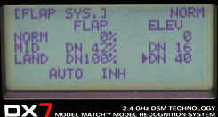
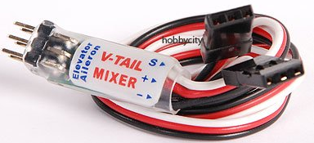
Controls Mixing – RC Transmitter (Tx)
Read each transmitter’s instructions
Example: Spektrum radios; Enter menu → Mixing → Set mixes 1 – 3
Flaps mixes (e.g. to deflect elevator) done in the Flaps System menu
This image shows a transmitter with a 3-position switch used for flaps (normal)
Make sure deflections are in the correct direction
Don’t want elevator down when flaps deploy, or else you’re going down REALLY fast
For V-tail
Glider this fall (no Pixhawk); Set up the Tx with native v-tail mixing (usually in wing/tail setup menu or similar) or use a standalone v-tail mixer.
With Pixhawk; Do not use Tx v-tail mixing. Re-assign servo outputs for elevator/rudder as left and right v-tails

Slide 17
Servos – Common issues/FAQs
Make sure your servos are being powered by an appropriate source
Example of good setup: 5V, 5A BEC powering normal-sized servos
Example of bad setup: 5V, 2A BEC powering normal sized servos
Leads to voltage sag, possibly brown-outs
Make sure your servos are centered when installing them
Example: You take servos straight out of the box, put a servo horn perpendicular to the flat side, and put it in your wing. You power on the servo, and send it a 1500 μs signal. It deflects 45°, and now you must uninstall the servo, move the horn, and reinstall the servo.
“My servo is deflecting the wrong way.” (Looking like flaps instead of ailerons)
More of an issue when using a servo “Y” cable and a low-channel receiver
If plugged into its own channel in the Pixhawk, reverse that output
Some digital servos can be reversed on the servo, but analog servos can not.

Slide 18
Servos – Common issues/FAQs
“My servo isn’t moving at all.”
90% of the time a servo wire is hooked up incorrectly
Check your GCS servo output page to see if a signal is being sent
Make sure the servo is powered (battery, BEC, etc) powering the servo rail
“The servo is all jittery.”
Servo rail voltage may be too high/low
Sometimes servos have a tiny bit of jitter because of their dead band circuitry
Usually goes away under load
“Why is the servo getting so hot?”
May be overloaded (more torque than the servo can handle)
Servo rail voltage may be too high/low

Slide 19

Suggestions
Read your product manuals
Or at least skim the important parts
Valuable tidbits like “How to hook everything up”
Set up an “iron bird”
Basic testbed for your electronics, mounted to one piece of material so you can carry it around
Can include Pixhawk, servos, batteries, GPS, etc.
Can make it in 5 minutes out of foamboard and tape – it need not be pretty
Try to have access to a digital multimeter
Best basic electrical troubleshooting tool
Voltage testing
Continuity testing

Slide 20
Suggestions
List out all electrical connections before you purchase components
Figure out if you need to replace a battery, ESC connector, etc.
Figure out if you need to buy different size bullet connectors for your motor/ESC
Build an electrical budget (for power draw, not $$)
Investigate whether any additional systems will require separate power sources due to voltage differences or system architecture reasons
Produce a nice (high quality) and easy-to-follow electrical diagram
Include cable and connector types, peripherals, what power is going where, etc.
Does not need to be analogous to the aircraft layout, but it can be

Slide 21
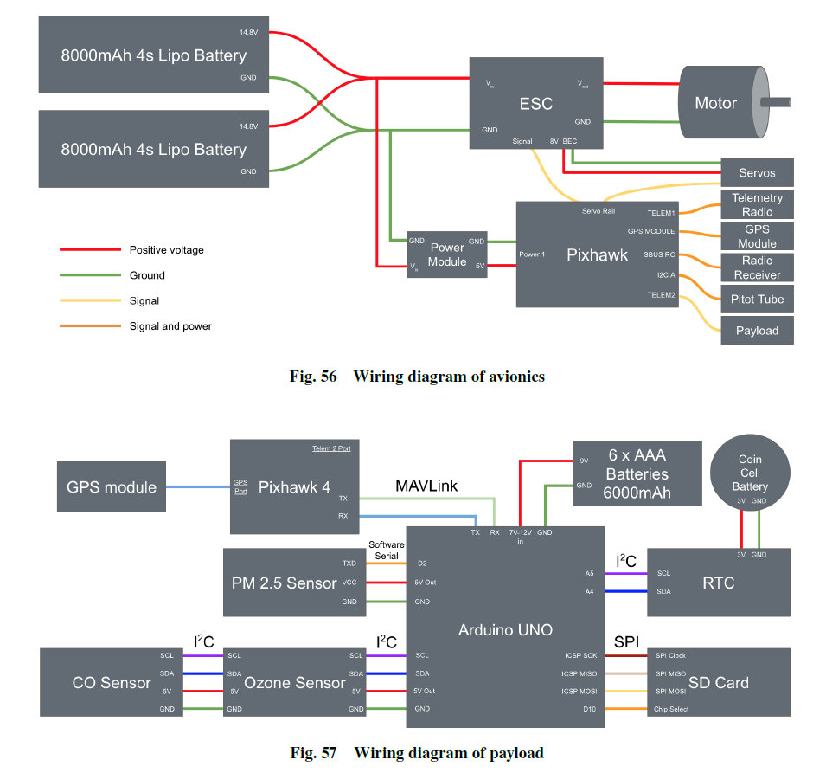
Example
Wrong
Not perfect
It is CLEAR
It includes all components
Except connectors…
It breaks down the complex system
Pixhawk wiring separate from payload system
Shows the interconnectivity between the two

